Slide 1
ML Pipeline for Clinical Trial Data
SDSS Abstract #1966
Juliane Manitz, Aslihan Gerhold-Ay, Pascal Kieslich
EMD Serono/Merck Healthcare KGaA Darmstadt Germany

Slide 2
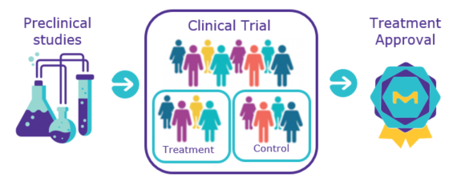
Phase 3 Clinical Trial Data
Survival data from case-control study comparing a novel immuno-oncology drug with conventional chemotherapy.

Slide 3

Research Question
Is there a subpopulation that will particularly benefit from a novel immuno-oncology (IO) treatment in comparison to conventional chemotherapy?
Definition as ML Problem
Dependent variable: Overall survival, the time from treatment initiation to death from any cause; patients alive or lost to follow-up are censored.
Features: Treatment group, patient demographics, disease characteristics, laboratory values, patient-reported outcomes, biomarkers, etc.
Notes:
We investigate heterogeneity in treatment effect and survival
Searching for subpopulations that will particularly benefit from a novel immuno-oncology (IO) treatment in comparison to conventional chemotherapy.

Slide 4
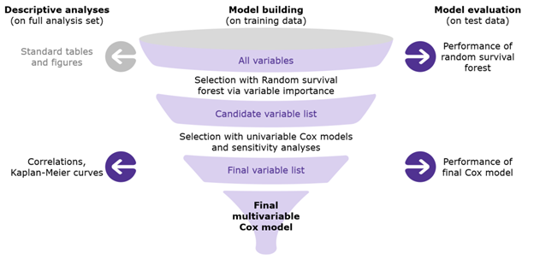
Illustration of the Machine Learning Pipeline

Slide 5
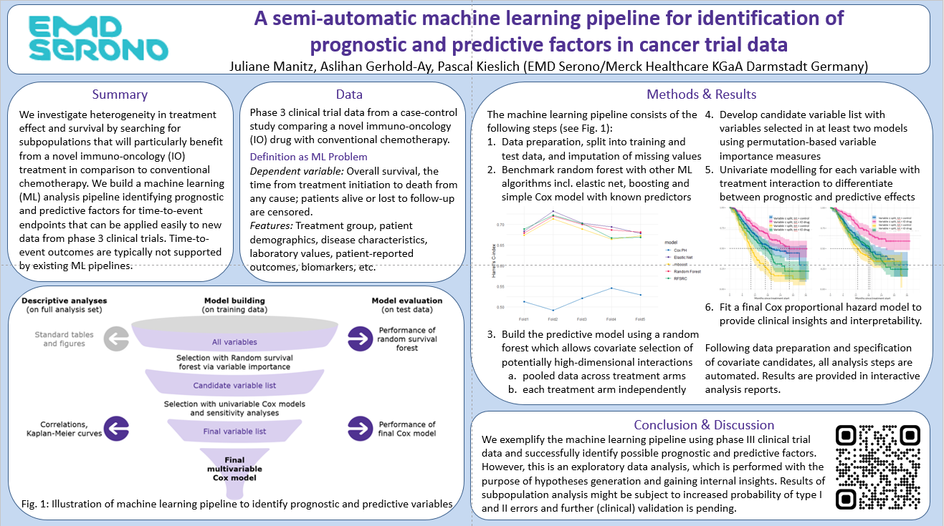

You Want to Know more Details?

